Slide 1
Image Detection with RISCV Processor on FPGA
Joshua Wallace
Supervisor: Matthew D’Souza

Slide 2
Overview Demonstrating how FPGAs can be used to accelerate image processing methods.
01 | Context and Background | 3-7
 | FPGAs, RISC-V, Image Processing, Processing Techniques, Hardware Acceleration
02 | Implementation | 8-10
 | Hardware Implementation, Software Implementation, Architecture
03 | Progress | 11
04 | Benchmarking | 12
05 | Plan | 13
06 | Challenges | 14
07 | Contact | 15

Slide 3
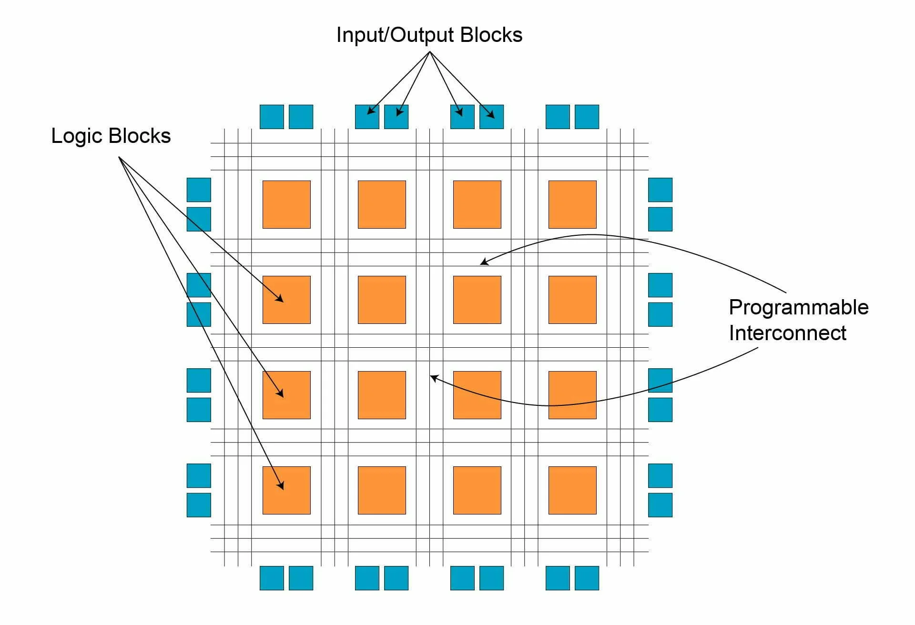
FPGAs
Field programmable gate array
Reconfigurability allows for specific algorithms
Parallelised processing for efficient algorithm execution.
Low-latency processing for real-time applications.
Low-power consumption advantage for embedded systems.

Slide 4




RISC-V
Reduced instruction set architecture
Open-source instruction set architecture (ISA)
Extensible; can have custom instructions
Control over hardware resources for embedded systems
Produces simple, minimal SoC designs

Slide 5
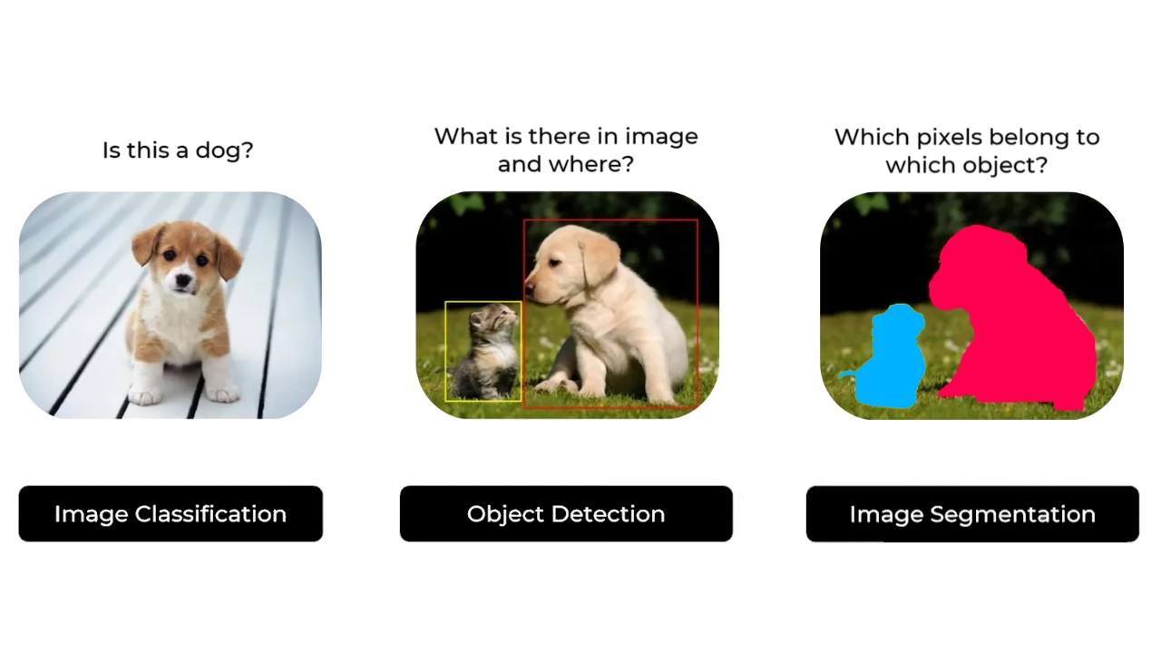
Image processing
Retrieving information from an image
Real-time processing has strict timing constraints
Increasing algorithm complexity and large volumes of data means efficient algorithms are required
Processing methods include:
Segmentation
Edge detection
Object detection
Image classification and more

Slide 6
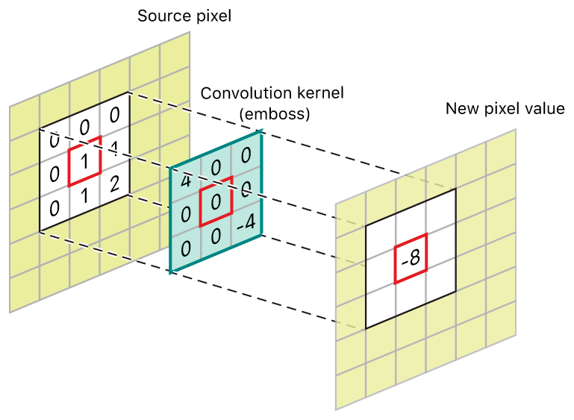
Processing Techniques
Types and common techniques
Processing extracts features from an image
Edge detection and kernel gradient form the basis of most techniques
Sobel, Prewitt, Canny, Laplacian filter are common edge detection techniques using gradient/gaussian methods
Processing techniques moving in the direction of neural nets (CNNs) via convolution

Slide 7
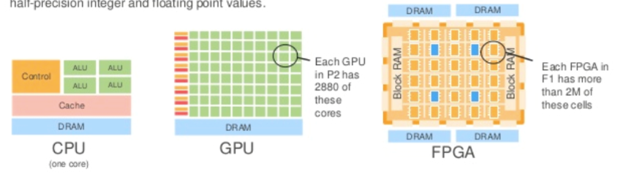
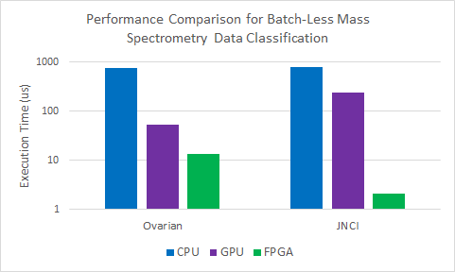

Hardware acceleration
Leveraging FPGAs for high throughput and low latency
CPU/MCU can execute sequentially
GPU/FPGA allow for parallel architectures
FPGAs allow for application-specific accelerators which are deterministic: Memory access, threading etc
GPUs are general-purpose parallel computation
Not optimal for big data or deep learning tasks as FPGAs more resource constrained

Slide 8




Software implementation
Using Python and C for software definitions.
On-chip in software vs hardware definitions
CPU programming offloads compute intensive tasks to hardware
Python scripts required to retrieve network parameters
Dedicated hardware components execute algorithms, generally by multiplier accumulator (MAC) units
Notes:
Many IO operations, loads. Software is simpler

Slide 9
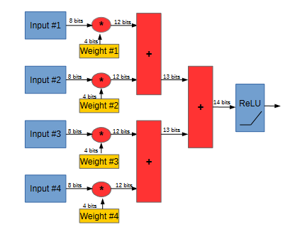
Hardware implementation
Implementing processing algorithms in VHDL
Written for Xilinx Artix 7 Family FPGA (XC7A35TICPG236-1L)
RISC-V softcore processor (NeoRV32)
Processor written in VHDL, connected via Wishbone bus to hardware resources
Methods implemented using DSPs and LUTs
Neurons defined in hardware

Slide 10
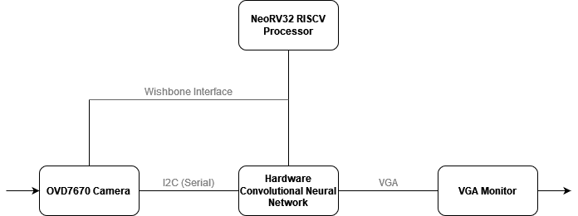
Architecture and Development
FPGA image processing pipeline from camera to VGA output
Using Digilent Basys 3 development board.
Input image (640x480 pixels) stored into BRAM from peripheral camera module
Processing performed in hardware
Output image / classification written to BRAM
Control processing via FSM to ensure timing

Slide 11
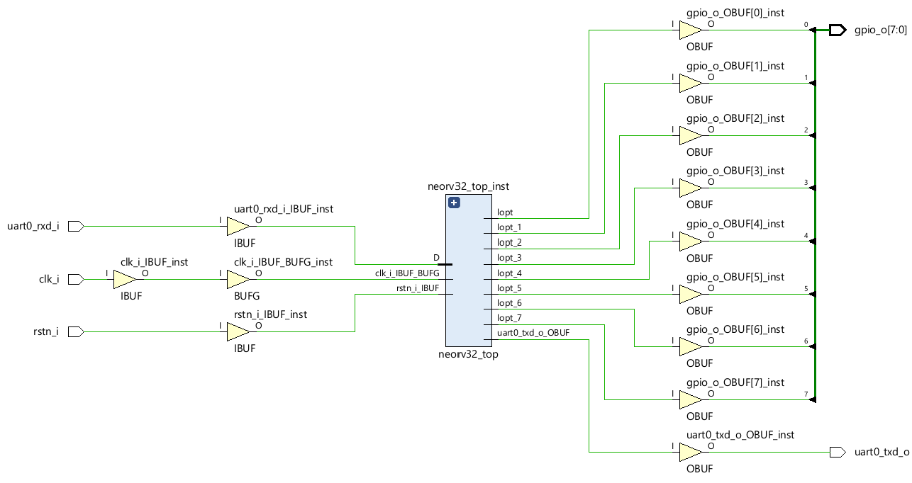
Progress
Status of the work
NeoRV32 softcore processor with Wishbone B4 interconnect implemented on Basys 3.
Python scripts and notebooks for selected techniques.
Single-layer MNIST CNN trained for classification with weights exported via ONNX from Pytorch.
Generating hardware implementations of a CNN: Neuron, ReLu, Convolution.

Slide 12



Benchmarking
Testing the performance
Inference time / Execution time
Benchmark performance against common applications
FPGA hardware / software
CPU only
CPU with GPU accelerator
Embedded devices
Detection verified by MSE; classification verified by validation loss / accuracy
Notes:
Decrease critical path

Slide 13
Plan
Where is the project going?
01
02
03
04
RISCV Softcore Processor
Custom Hardware and Software
Peripherals
Benchmarking
NeoRV32 processor on Basys 3
Wishbone B4 interconnect
Define algorithms in hardware (VHDL)
Define algorithms in software (Python, C)
Connect pipeline to OVD7670 camera for input
Display output on VGA monitor
Integrate and test
Measure inference times and compare

Slide 14
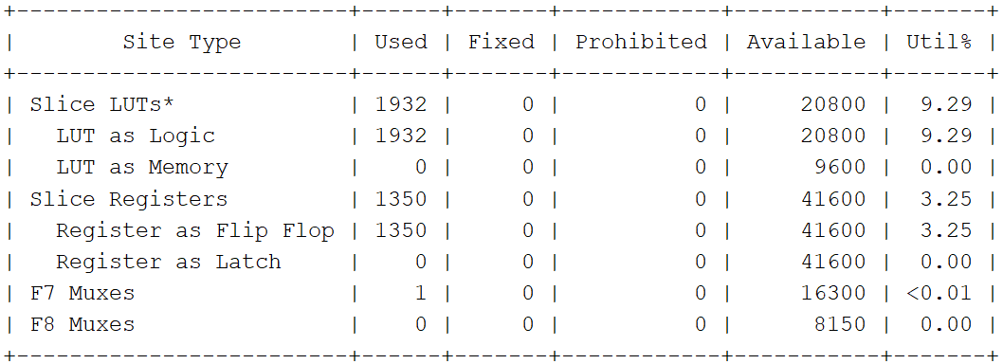
Challenges
Potential issues identified
BRAM resources on Basys 3 is limited for storing and retrieval of image data → Change board
Fixed point arithmetic requires selecting minimal bit widths without loss of accuracy
Resource utilization for defining a convolution layer
Multiplication can be done in LUTs or DSPs
Limited number of DSP slices

Slide 15
Contact
Joshua Wallace
Image Detection with RISCV Processor on FPGA
joshua.wallace1@uq.edu.au

